Slide 1
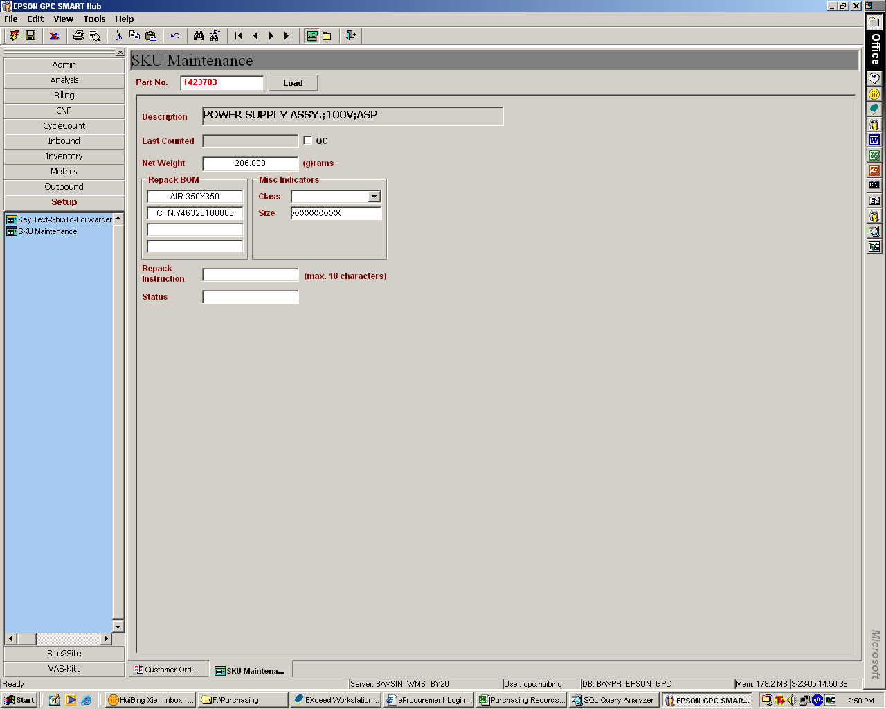
Include the Commodity Group
E.g. 100

